Slide 1
Generating Preview Tables for Entity Graphs
#Ning Yan, *Sona Hasani, *Abolfazl Asudeh, *Chengkai Li
#Huawei U.S. R&D Center
*University of Texas at Arlington, Innovative Database and Information Systems Research (IDIR) Laboratory
SIGMOD 2016, June 30th, 2016

Slide 2
Entity Graph
Entity
Will Smith
FILM ACTOR
FILM PRODUCER
Executive Producer
I, Robot
FILM
Actor
Science Fiction FILM GENRE
Genres
Men in Black
FILM
Genres
Action Film
FILM GENRE
Relationship
Director
Producer
Barry Sonnenfeld
FILM DIRECTOR
Laurie MacDonald
FILM PRODUCER
Entity Type

Slide 3
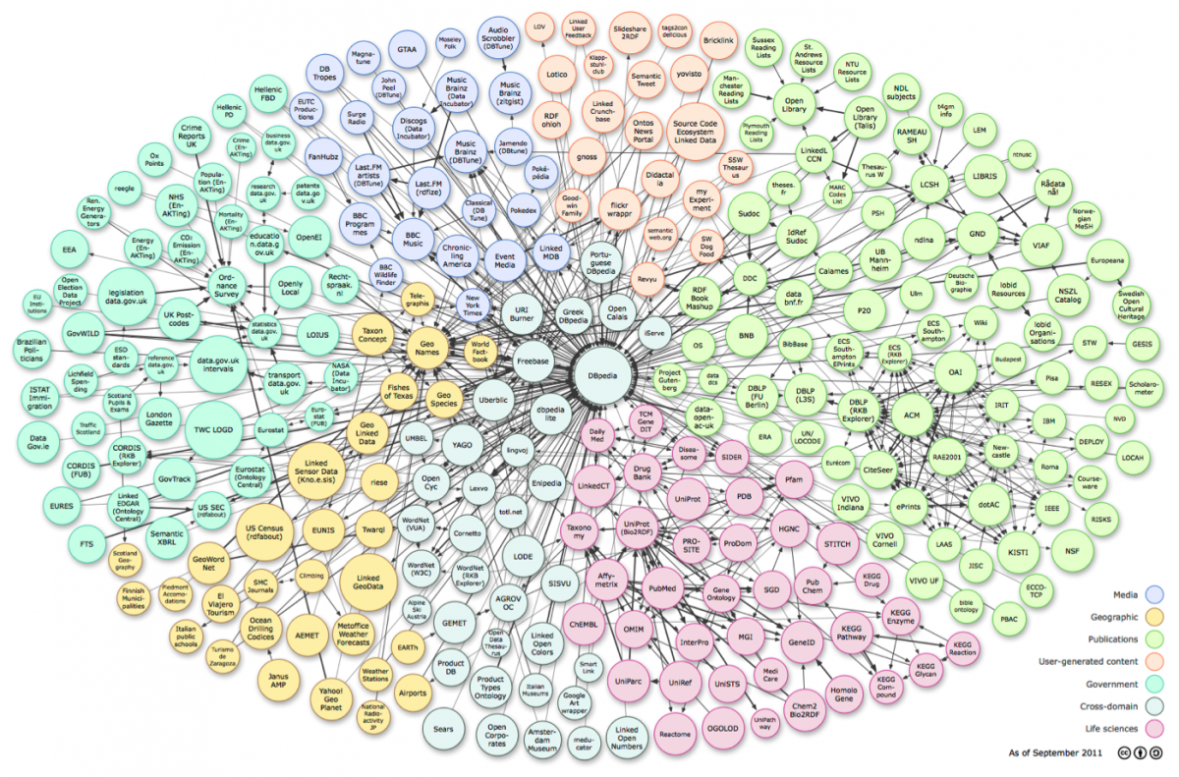
Ultra-heterogeneous Entity Graphs
Large and complex graphs capturing millions of entities and billions of relationships between entities.
Applications: search, recommendation systems, business intelligence, health informatics, fact checking
Freebase : 1.9 billion triples
DBpedia : 3 billion triples
YAGO : 120 million triples
Linked Open Data : hundreds of datasets 52 billion RDF triples
http://linkeddata.org/

Slide 4




Steep Flag-Down Cost
Find a dataset
Does it provide the required information?
Start building applications
Put effort and time to read the documents
Download a few hundred Gigabytes of data
Learn the dataset’s structure and upload it into a database

Slide 5
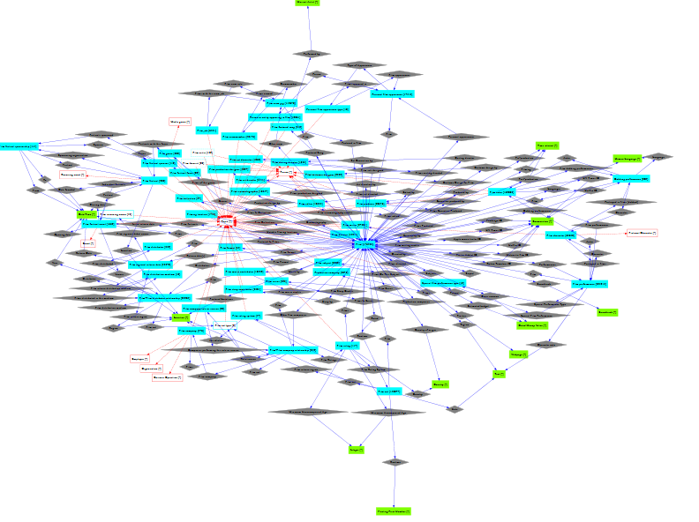
Need for a Quick Overview
Approach 1: Schema Graph
Schema graph itself can be too complex
AWARD
Award Winners
FILM ACTOR
Actor
FILM
ExecutiveProducer
Director
FILM DIRECTOR
Producer
FILM PRODUCER
Genres
Schema graph of “Film” domain in Freebase
Entity graph: 2M entities, 18 M edges
Schema graph: 63 entity types ,136 edges
FILM GENRE

Slide 6
Need for Quick Overview
Approach 2: Schema Summary
Schema summarization in relational database [Yang PVLDB09, Yang PVLDB11]
Cluster tables in relational database by their semantic roles and similarities.
Clusters tables, not relationships
Detailed
XML summarization [Yu VLDB06]
Provide a succinct overview of the entire schema graph
Graph summarization [Tian SIGMOD08, Zhang ICDE10]
Group graph nodes based on their attribute similarity and allow users browse the summary from different grouping granularities.

Slide 7
Preview Tables
Key attributes
Non-key attributes
Award Winners
Executive Producer
Saturn Award
AWARD
Will Smith
FILM ACTOR FILM PRODUCER
I, Robot
FILM
FILM ACTOR | Award Winners
Will Smith | Saturn Award
Actor
Actor
Genres
Men in Black II
FILM
Genres
Action Film
FILM GENRE
Genres
Men in Black
FILM
Genres
Genres
Science Fiction FILM GENRE
Director
Director
Producer
FILM | Director | Genres
Men in Black | Barry Sonnenfeld | {Action Film, Science Fiction}
Men in Black II | Barry Sonnenfeld | {Action Film, Science Fiction}
I, Robot | _ | Action Film
Barry Sonnenfeld
FILM DIRECTOR
Laurie MacDonald
FILM PRODUCER

Slide 8
Too Many Previews. Which one to Choose?
Many possible previews
Different choices
Preview A
Preview B
FILM | FILM SET DECORATOR | FILM EDITOR
FILM | FILM DIRECTOR | FILM PRODUCER
PRODUCTION COMPANY | FILM
FILM WRITER | FILM

Slide 9
Aggregate Scoring
Score of the Table?
Score of the Preview?
FILM | Actor | Genres
4 | 6 | 5
4 × (6+5) = 44
44+16= 60
FILM ACTOR | Actor | Award Winners
2 | 6 | 2
2 × (6+2) = 16

Slide 10
Key Attributes Scoring
Coverage-based method
Coverage(FILM) = 3
Random walk-based method
Stationary distribution of a random walk process defined over the schema graph
Executive Producer
Saturn Award
AWARD
Will Smith
FILM ACTOR FILM PRODUCER
I, Robot
FILM
Actor
Actor
Genres
Men in Black II
FILM
Genres
Action Film
FILM GENRE
Genres
Men in Black
FILM
Genres
Genres
Science Fiction FILM GENRE
Director
Director
Producer
Barry Sonnenfeld
FILM DIRECTOR
Laurie MacDonald
FILM PRODUCER

Slide 11
Non-key Attributes Scoring
Coverage-based method
Coverage(Genres) = 5
Entropy-based method
Entropy(Genres) = (2/3) log(3/2)+(1/3) log(3/1) = 0.28
Executive Producer
Saturn Award
AWARD
Will Smith
FILM ACTOR FILM PRODUCER
I, Robot
FILM
Actor
Actor
Producer
Genres
Men in Black II
FILM
Genres
Action Film
FILM GENRE
Genres
Men in Black
FILM
Genres
Genres
Science Fiction FILM GENRE
FILM | Director | Genres
Men in Black | Barry Sonnenfeld | {Action Film, Science Fiction}
Men in Black II | Barry Sonnenfeld | {Action Film, Science Fiction}
I, Robot | _ | {Action Film}
Director
Director
Producer
Barry Sonnenfeld
FILM DIRECTOR
Laurie MacDonald
FILM PRODUCER

Slide 12
Optimal Preview Discovery
Find the preview with highest score that satisfies
Size constraint
Number of key attributes K
Number of non-key attributes N
Distance between two preview tables d
Tight Diverse
dist(Ti, Tj) ≤ d
Concise
dist(Ti, Tj) ≥ d
FILM | Performances | Genres | Directed By
FILM FESTIVAL | Location | Focus
FILM DIRECTOR | Films Directed
FILM COMPANY | Films
FILM PRODUCER | Films Produced
FILM CHARACTER | Portrayed in Film
Tight
Diverse

Slide 13
Concise Preview, Dynamic Programming Algorithm
We assume all K key attributes are ordered arbitrarily.
optimal concise preview (k, n, X) is the best of:
optimal concise preview (k, n, X-1)
optimal concise preview (k-1, n-1, X-1) ∪ X-th Key-attribute with 1 non-key attribute
optimal concise preview (k-1, n-2, X-1) ∪ X-th Key-attribute with 2 non-key attributes
… …
optimal concise preview (k-1, k-1, X-1) ∪ X-th Key-attribute with (n-k+1) non-key attributes

Slide 14
Tight/Diverse Preview, NP-hardness
G_{s}
G
T1
T2
V6
T3
V1
V2
TightPreview (Gs, k, k, 1, 0)
T5
T4
V6
V3
T0
V5
V4
T1
T2
Clique(G,k)
T6
T3
DiversePreview (Gs, k, k, 2, 0)
T5
T4

Slide 15
Tight/Diverse Preview, Apriori Property Algorithm
1. Construct 2-cliques by enumerating all key attribute pairs
2. for i = 3 to k
generate i-cliques from (i-1)-cliques based on Apriori property
3. find the k-clique with highest score, return as optimal preview

Slide 16
Experiments
Dataset: Freebase
Accuracy of scoring measures
Compared with Freebase ground truth:
Key attributes: Precision-at-k (p@k), Average Precision, Discounted Cumulative Gain (nDCG)
Non-key attributes: Mean Reciprocal Rank (MRR)
Compared with crowd ranking:
Pearson Correlation Coefficient (PCC)
Efficiency of algorithms
Execution time
User study
Existence test questions
User experience questions

Slide 17
Key Attribute Scoring (p@k)
YPS09 [Yang PVLDB09]

Slide 18
MRR of Non-key Attributes (MRR)
Domain | Coverage | Entropy
books | 0.8 | 0.786
film | 0.2 | 0.25
music | 0.528 | 0.589
TV | 0.622 | 0.379
people | 0.708 | 0.606

Slide 19
Compare Rankings by Our Approach and the Crowd (PCC)
 | Key Attribute |  |  | Non-key Attribute
Domain | YPS09 | Coverage | Random Walk | Coverage | Entropy
books | 0.4 | 0.55 | 0.43 | 0.43 | 0.43
film | -0.01 | 0.48 | 0.25 | 0.35 | 0.35
music | 0.37 | 0.33 | 0.46 | 0.42 | 0.41
TV | 0.37 | 0.69 | 0.65 | 0.47 | 0.47
people | 0.36 | 0.31 | 0.29 | 0.43 | 0.43

Slide 20
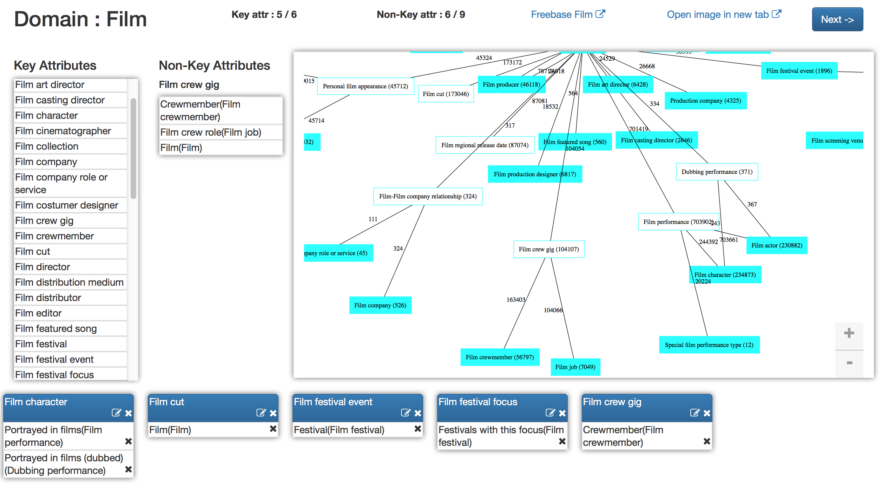
User Study, Hand-crafted Preview Tables
Domains: film books music TV people
Hand-crafted preview tables
10 PhD students in Database research group
Individually and as a group
$20 gift card

Slide 21
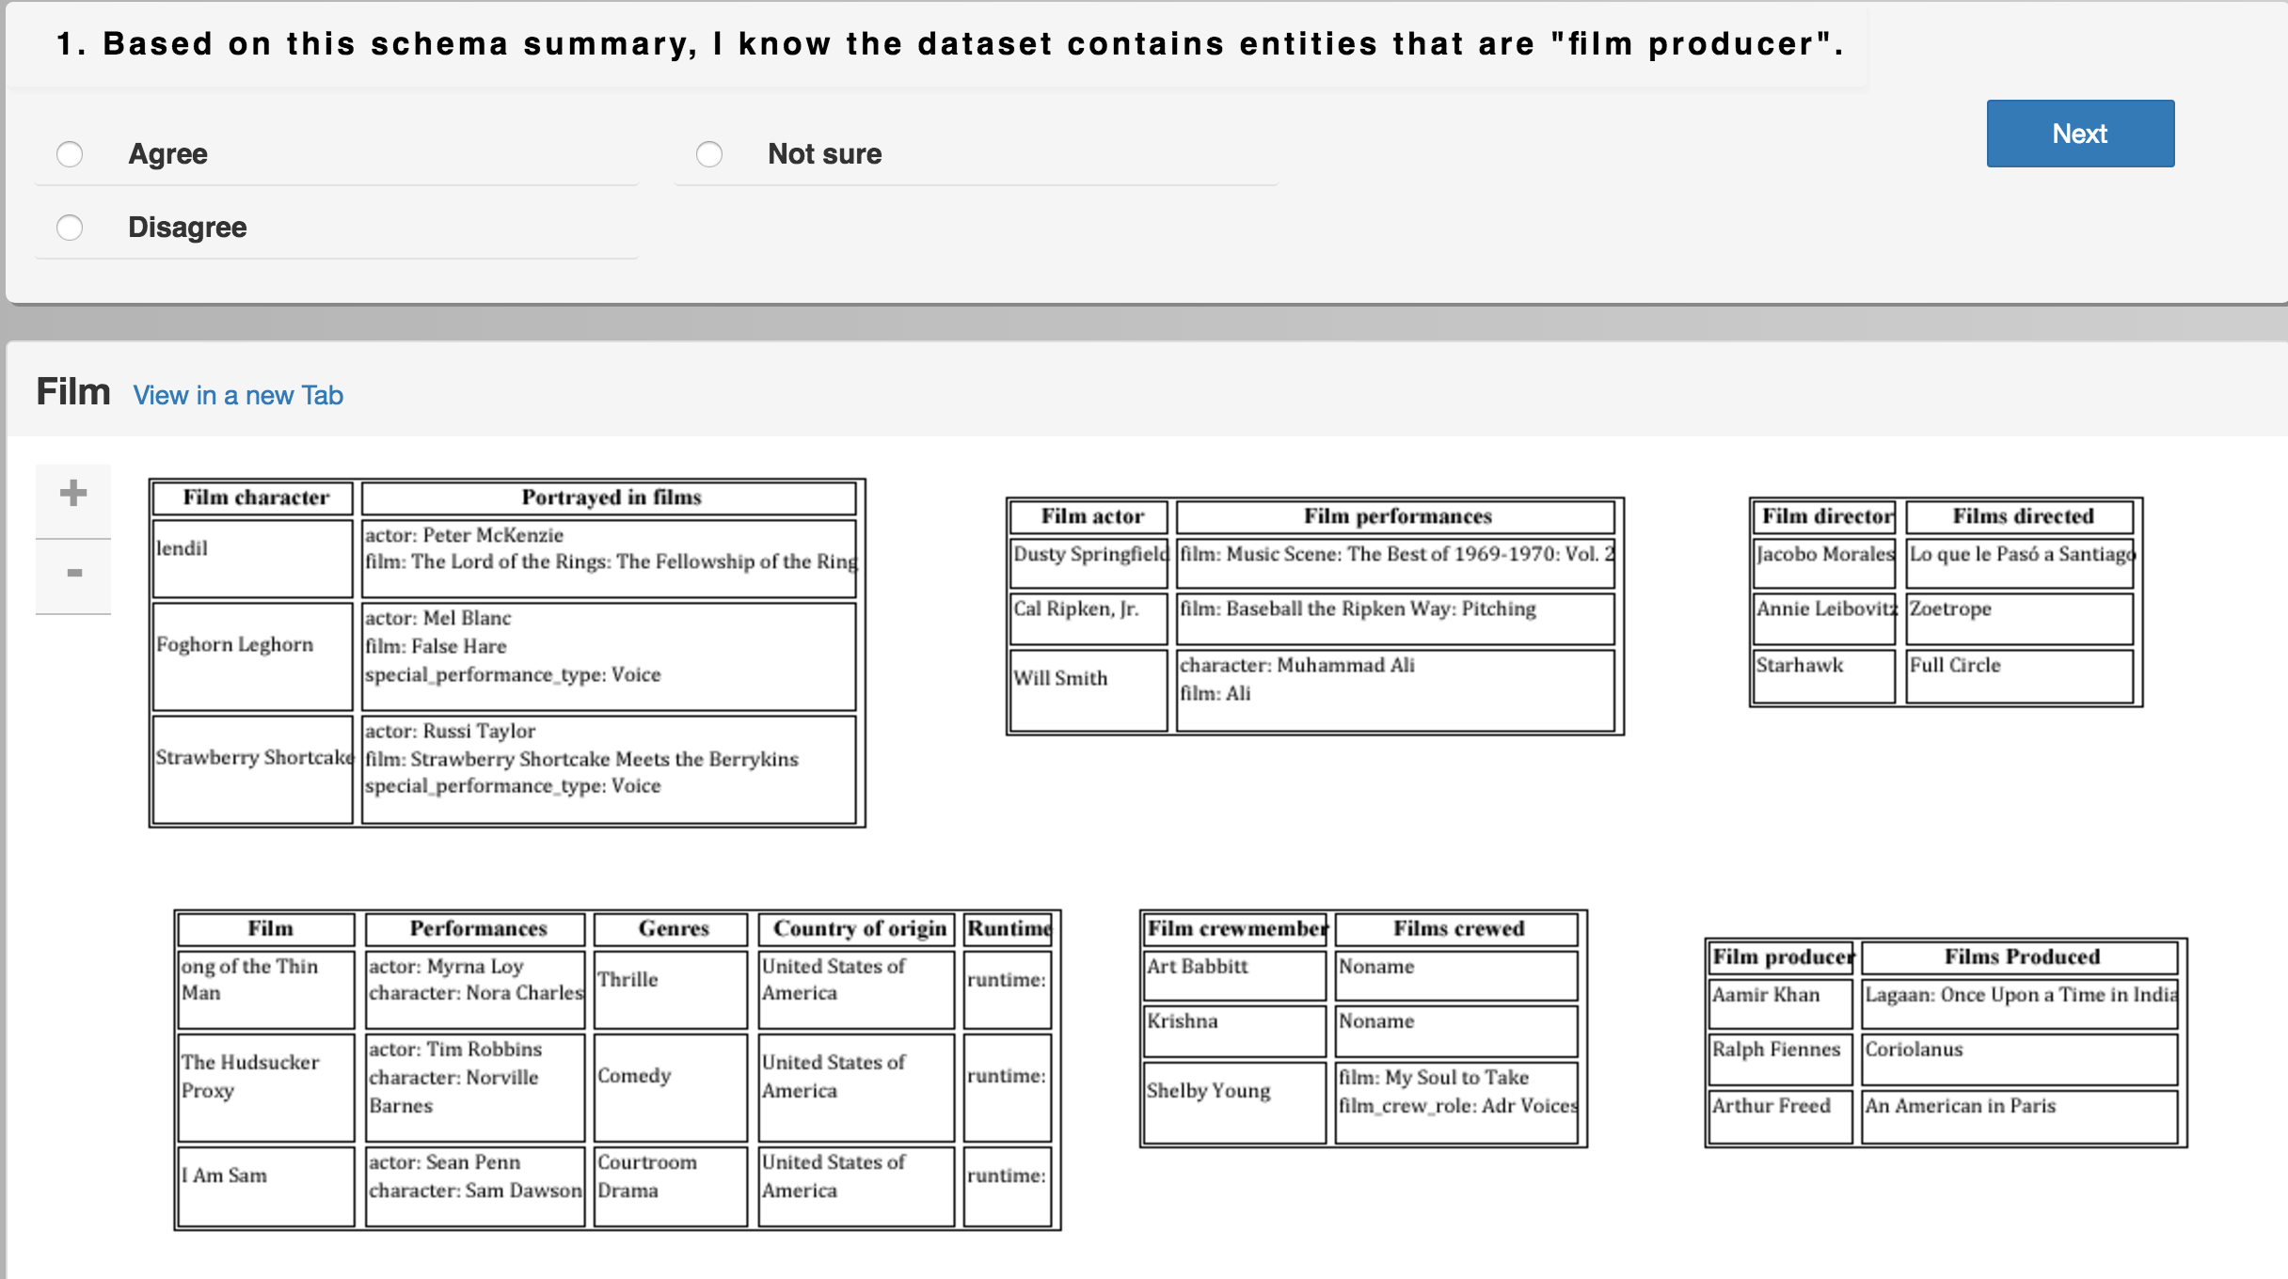
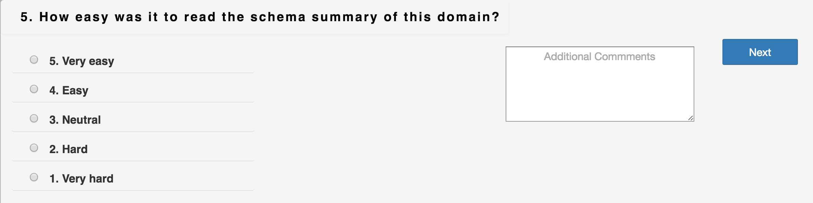
User Study, Approaches Compared
Domains: film, books, music, TV, people
Approaches:
Schema graph
Concise preview
Tight preview
Diverse preview
Freebase ground truth
YPS09
Hand-crafted preview tables
4 existence questions
4 experience questions
84 Master’s and PhD students in database area
$15 gift card

Slide 22
User Study: Existence Test Questions
 | Tight | Diverse | Freebase | Experts | YPS09 | Schema Graph
Concise | z=1.59 p=0.0559 | z=−2.28 p=0.0113 | z=0.49 p=0.3121 | z=−0.13 p=0.4483 | z=0.36 p=0.3594 | z=−0.43 p=0.3336
Tight |  | z=−3.48 p=0.0003 | z=−1.12 p=0.1314 | z=−1.69 p=0.0455 | z=−1.282 p=0.0999 | z=−1.93 p=0.0268
Diverse |  |  | z=2.57 p=0.0051 | z=2.10 p=0.0179 | z=2.60 p=0.0047 | z=1.70 p=0.0446
Freebase |  |  |  | z=−0.61 p=0.2709 | z=−0.15 p=0.4404 | z=−0.87 p=0.1922
Experts |  |  |  |  | z=0.49 p=0.3121 | z=−0.29 p=0.3859
YPS09 |  |  |  |  |  | z=−0.77 p=0.2206
Pairwise comparisons of conversion rates, domain=“music”, α=0.1

Slide 23
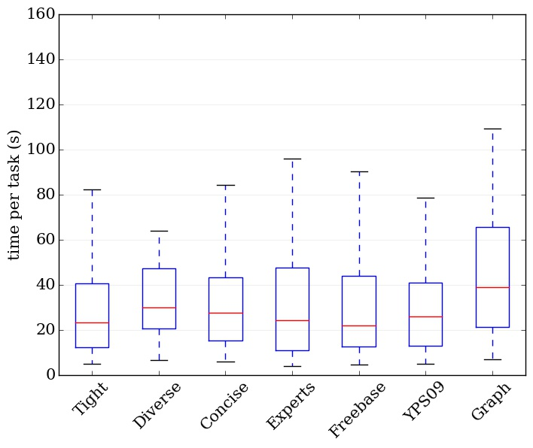
User Study: Existence Test Questions
Time taken on existence tests, domain=“music”

Slide 24
User Study: User Experience Questions
Questions
How easy was it to read the schema summary? | Freebase | Diverse | Graph | Experts | YPS09 | Concise | Tight
How much understanding of the data can you gain from it? | Graph | Freebase | YPS09 | Diverse | Concise | Tight | Experts
How helpful was it in assisting you to understand the data? | Graph | Freebase | YPS09 | Diverse | Experts | Concise | Tight
Is it missing important information? | YPS09 | Concise | Experts | Graph | Tight | Freebase | Diverse
most favorable
least favorable
Systems sorted by average user experience scores across five domains

Slide 25



Acknowledgment
Disclaimer: This material is based upon work partially supported by the National Science Foundation Grants 1018865, 1408928 and the National Natural Science Foundation of China Grant 61370019. Any opinions, findings, and conclusions or recommendations expressed in this material are those of the author(s) and do not necessarily reflect the views of the funding agencies.

Slide 26
Thank You! Questions?
Generating Preview Tables for Entity Graphs
Ning Yan, Sona Hasani, Abolfazl Asudeh, Chengkai Li

